Slide 1
SPM Lecture -4
29-Sept-2021

Slide 2
Class Rules for Discipline Violation of these 5 points will damage your marking for this course
No Noise making in the class.
No cross talking in the class.
Keep Mobile always on Silent/Vibrate mode in the class.(if found using mobile unnecessary during class, that mobile will be taken till End of Day)
Raise your hand to ask any question in the class.
Only make jokes if I allow you in the class.

Slide 3
DARK STARS of Class 3
Urooj Areeba Zeeshan Asad Muzeef Ahmed Hamza Ansari Hafsa Sundus Abeera Ayesha | Rimsha Habiba Omer Nabeel Nehal Humza Hamza 058 Hannan Taha Mehroz

Slide 4
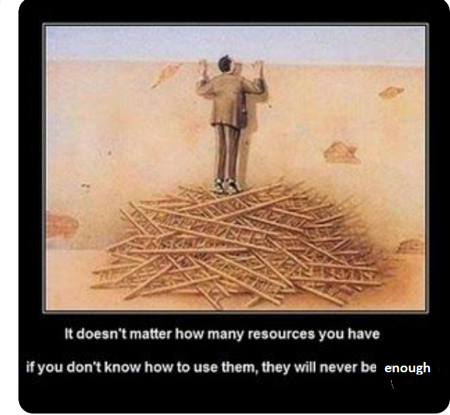

Slide 5
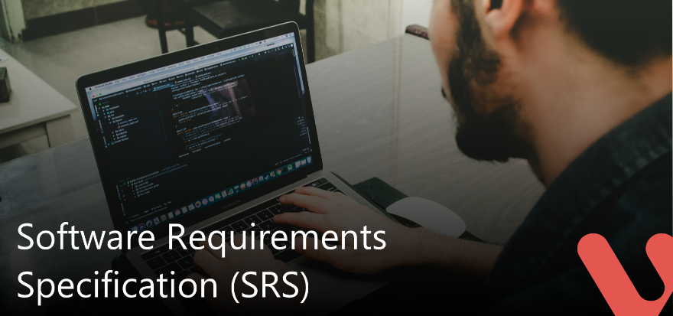
SRS- Document
A software requirement specification (SRS) is a comprehensive document that explains the descriptions/details of a software product/system to be developed with its functional and non-functional requirements.
(SRS) is developed based on the agreement between customer and supplier.
SRS helps to reduce the time and effort to develop software.
To develop the software system we should clearly understand the Software requirements.

Slide 6
To achieve this we need to continuously communicate with clients to gather all related information and requirements.
If there is no SRS document, Software developers will not know whether they are developing the product according to the customer need.

Slide 7
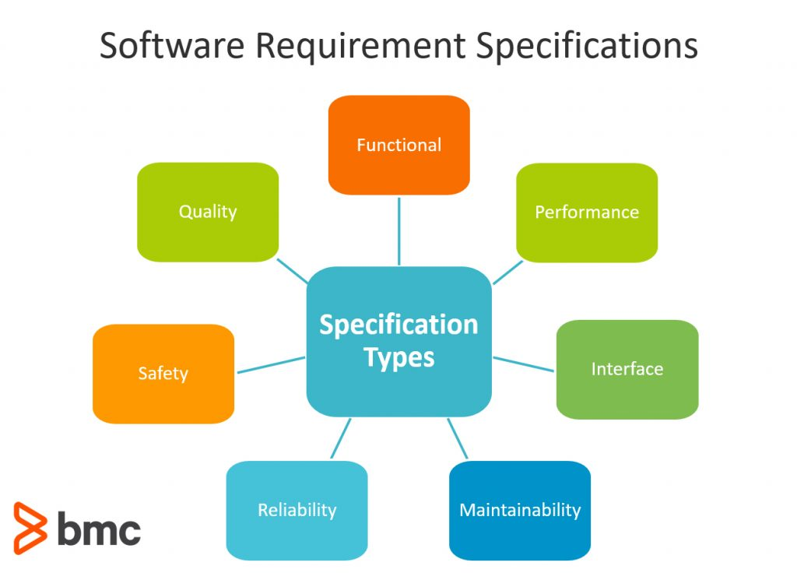

Slide 8
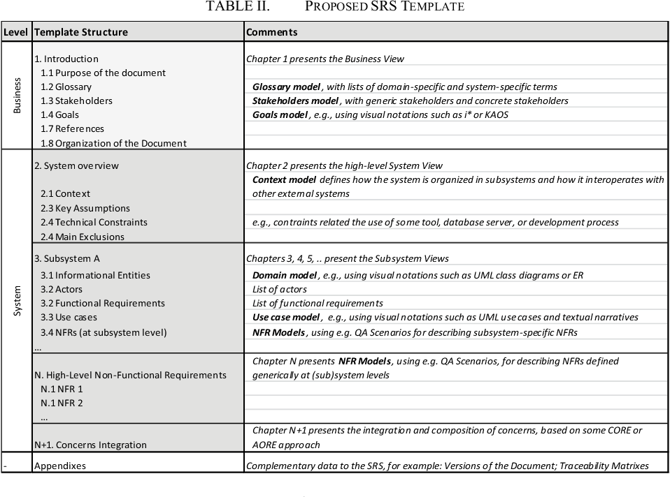

Slide 9
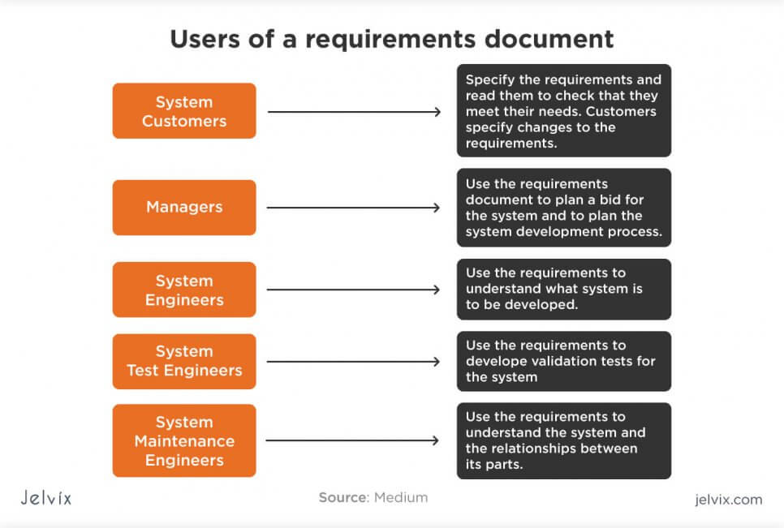

Slide 10
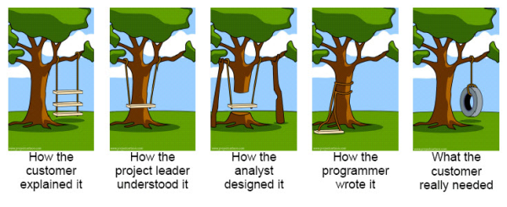

Slide 11
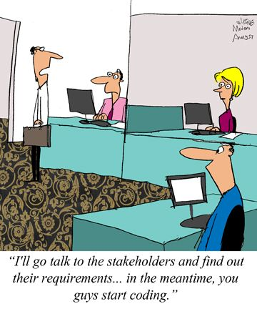

Slide 12
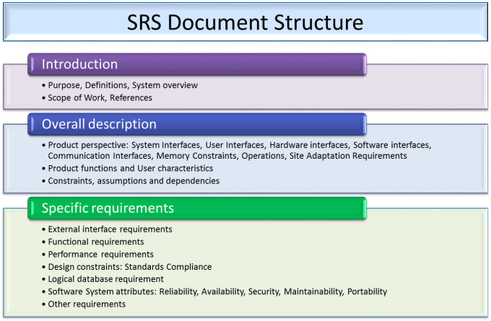

Slide 13
WBS- Work Breakdown Structure
“A work breakdown structure defines all the things a project needs to accomplish, organized into multiple levels, and displayed graphically.”
the WBS defines the “what” of the project. Everything you need to accomplish in the project is displayed in a single, easy to understand chart.

Slide 14
4 Levels of WBS
There are four main levels of a WBS, which are outlined below:
The Top Level: The project title or final deliverable.
Controls Account: The main project phases and deliverables.
Work Packages: The group of tasks that lead to the controls account level.
Activities: The tasks needed to complete the work package.

Slide 15
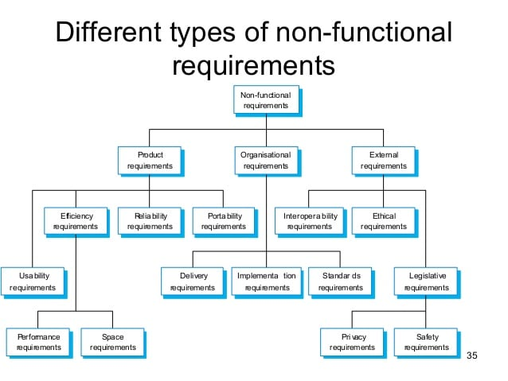

Slide 16
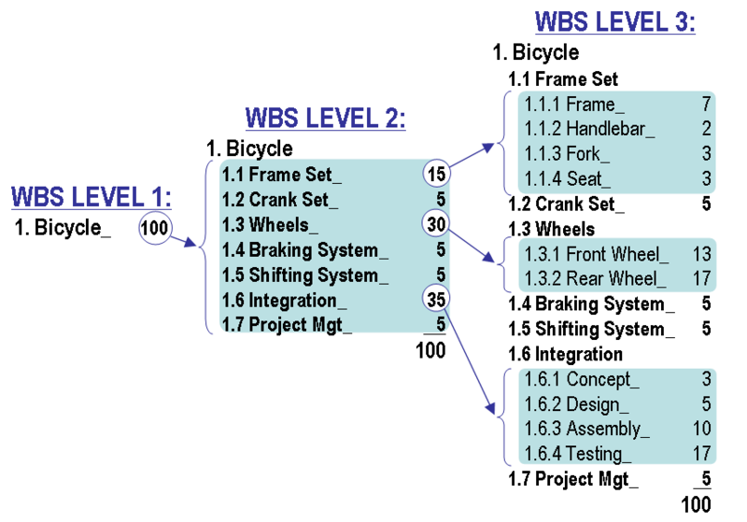

Slide 17
A Work Breakdown Structure includes dividing a large and complex project into simpler, manageable and independent tasks
Steps:
Step-1: Identify the major activities of the project.
Step-2: Identify the sub-activities of the major activities.
Step-3: Repeat till undividable, simple and independent activities are created.

Slide 18
Advantages of WBS
It allows to do a precise cost estimation of each activity.
It allows to estimate the time that each activity will take more precisely.
It allows easy management of the project.
It helps in proper organization of the project by the top management.

Slide 19
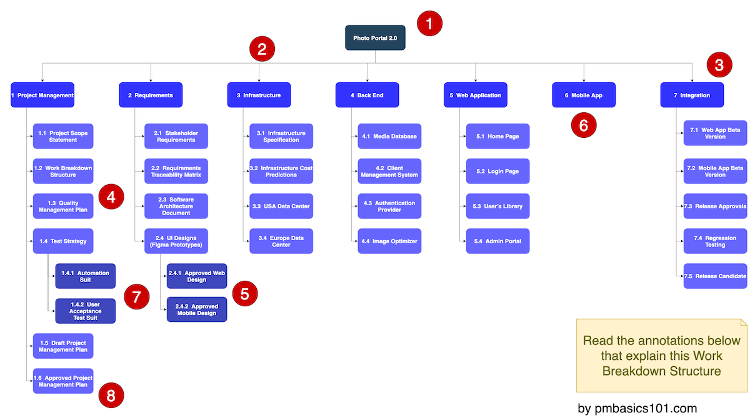

Slide 20
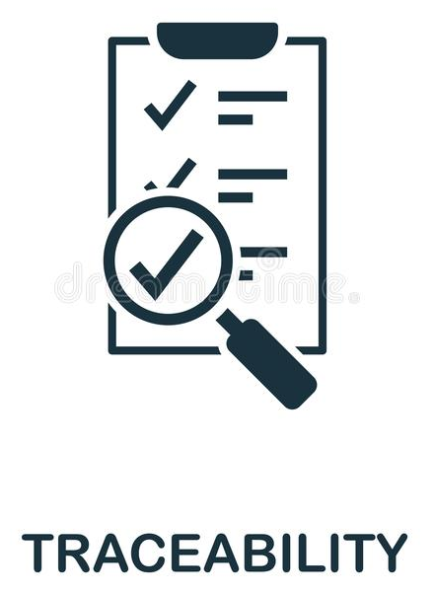
TRACIBILITY
Traceability describes relationships between two or more elements throughout the development process. ...
In project management, requirement traceability outlines the relationship between customer requirements through a Requirement Traceability Matrix.
Requirements Traceability Matrix is a document that maps requirements with other aspects of a project.

Slide 21
Requirements Traceability Matrix (RTM)
It’s a connection link between project objectives, requirements, and scope of work.
RTM is a document used to ensure that the requirements defined for a system are linked at every point during the verification process.
It also ensures that they are duly tested with respect to test parameters and protocols.

Slide 22
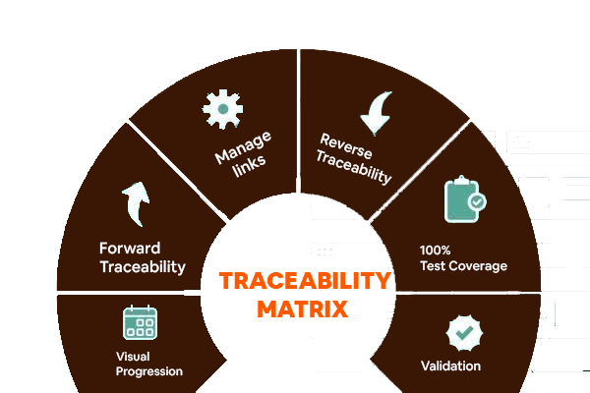

Slide 23
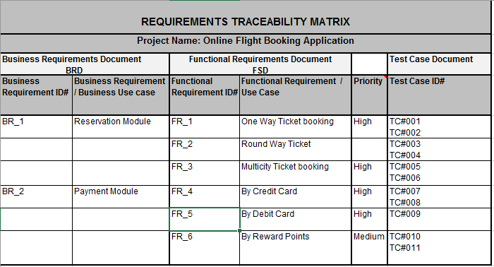

Slide 24
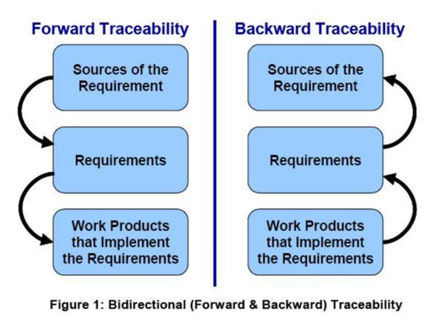
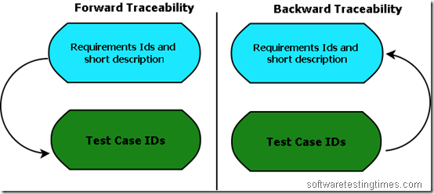

Slide 25
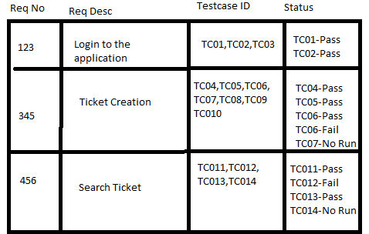
Detail Reading https://www.inflectra.com/ideas/topic/requirements-traceability.aspx

Slide 26
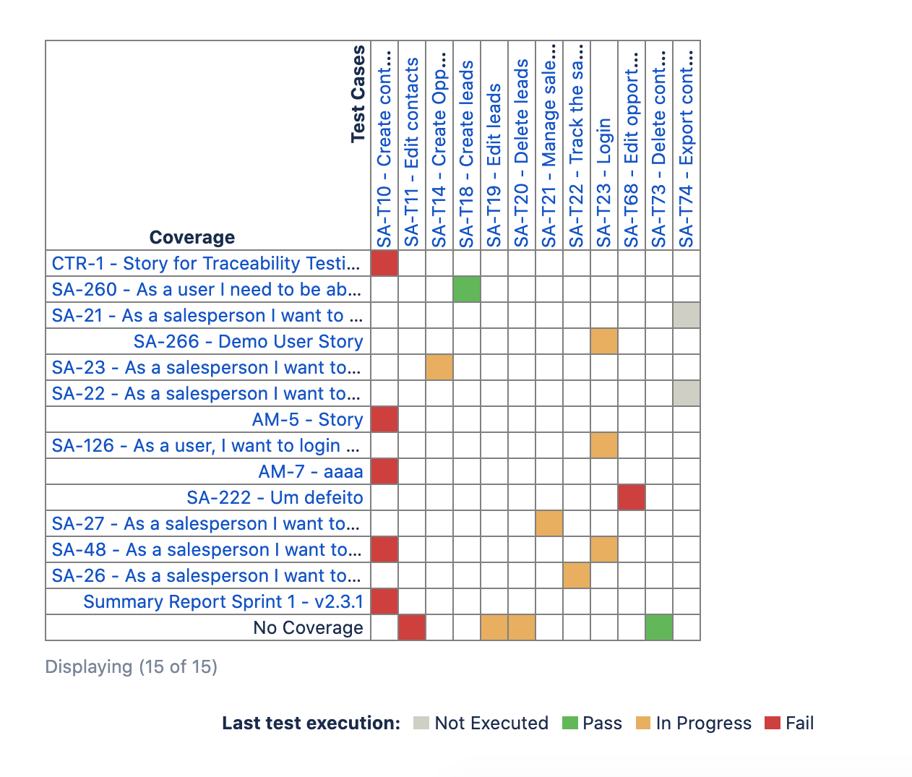

Slide 27
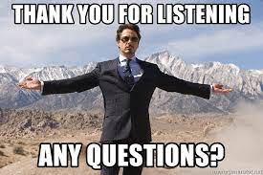

Slide 28
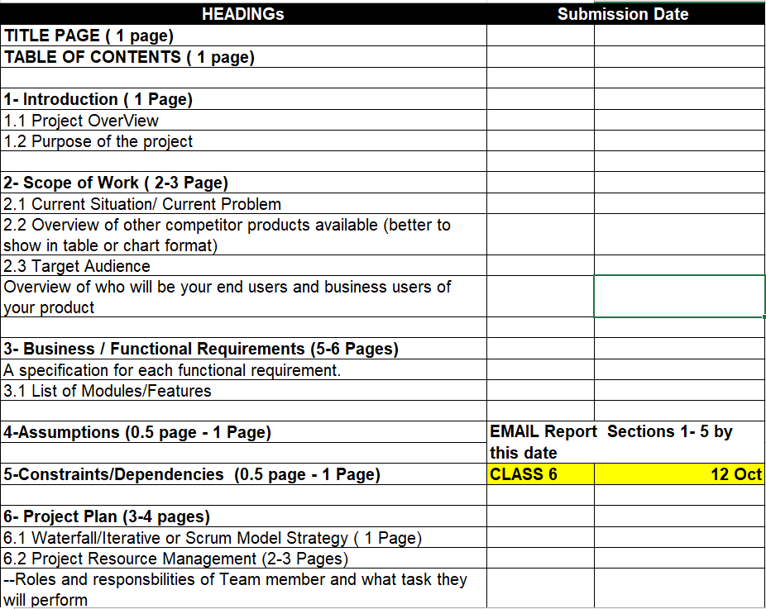

Slide 29
